Slide 1

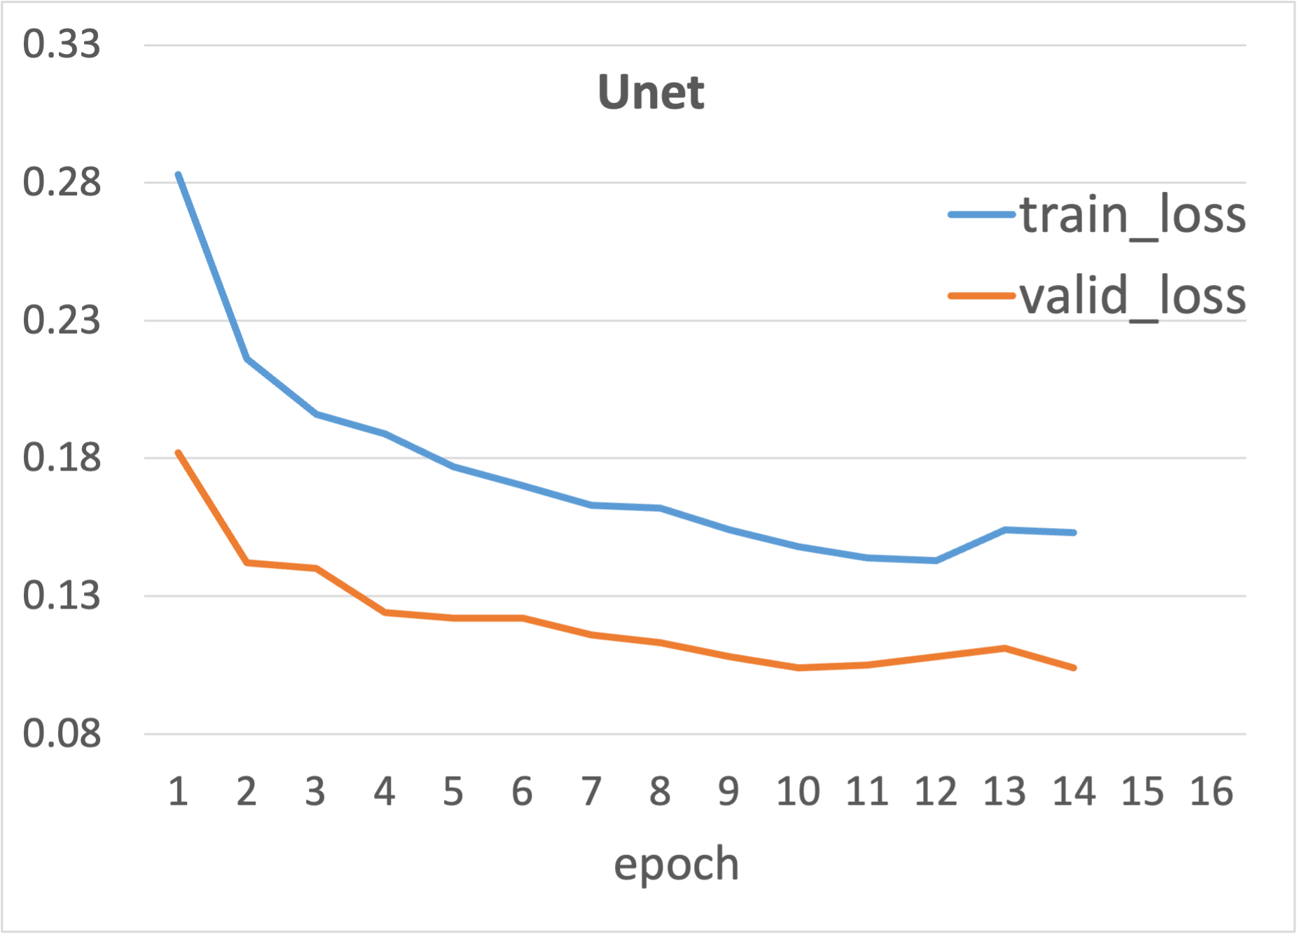
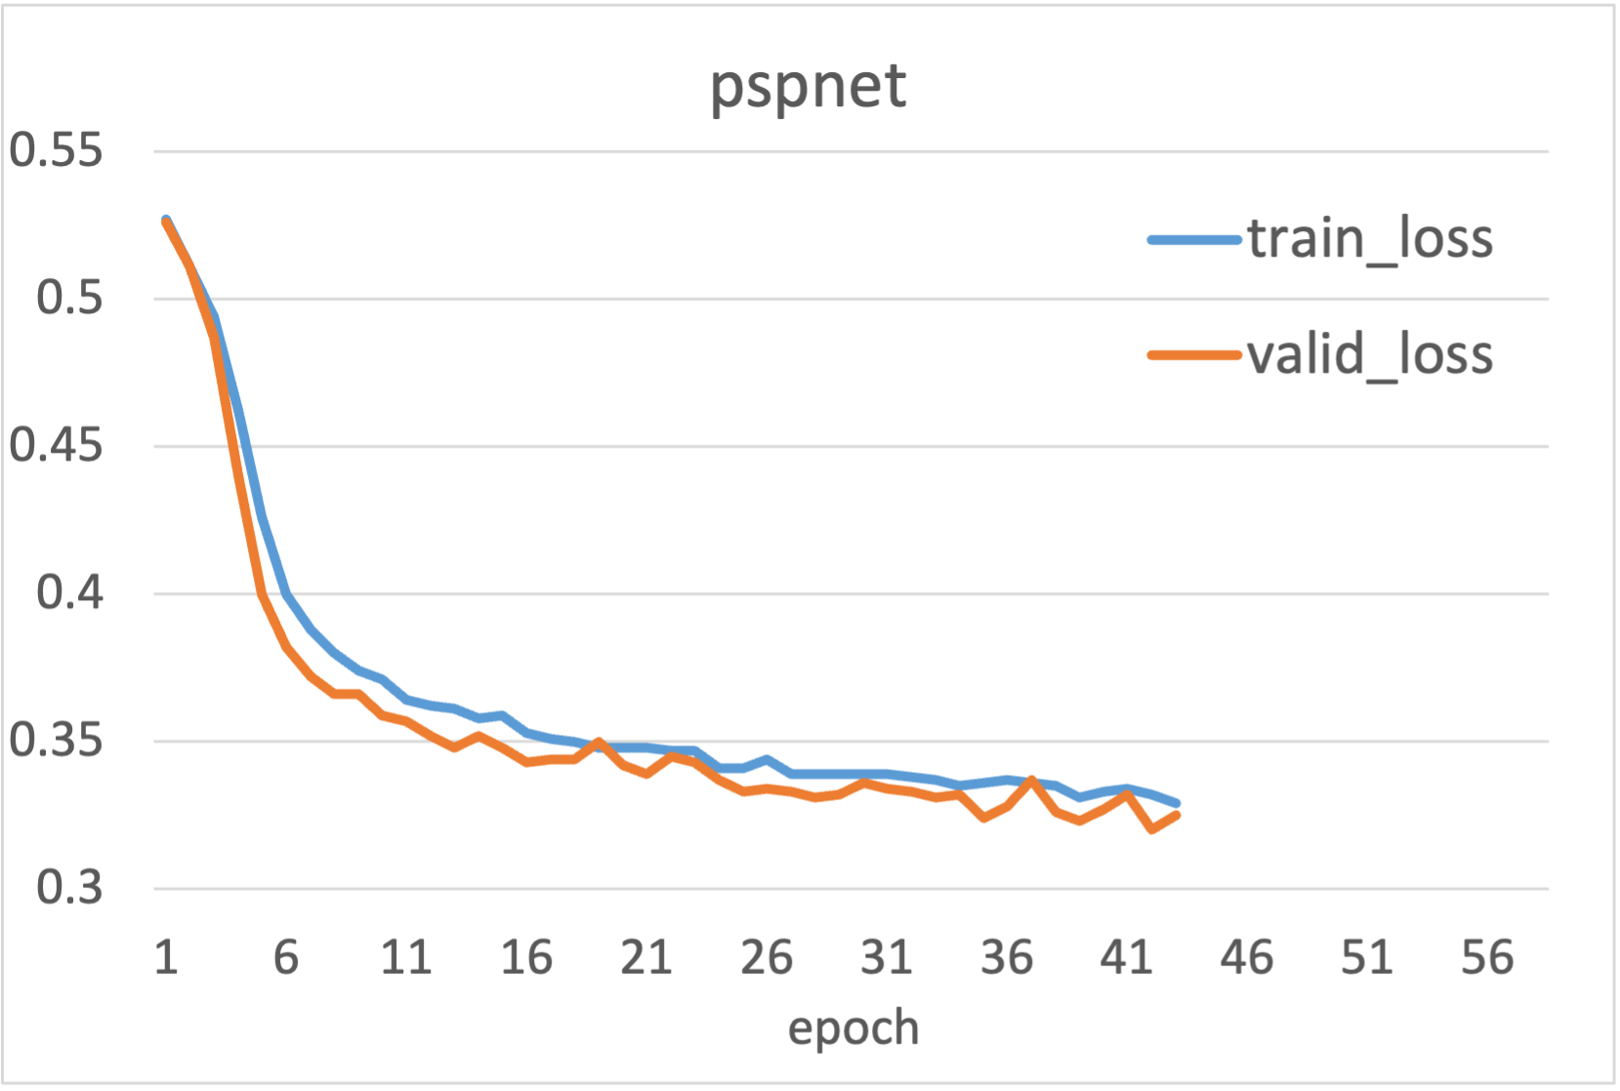
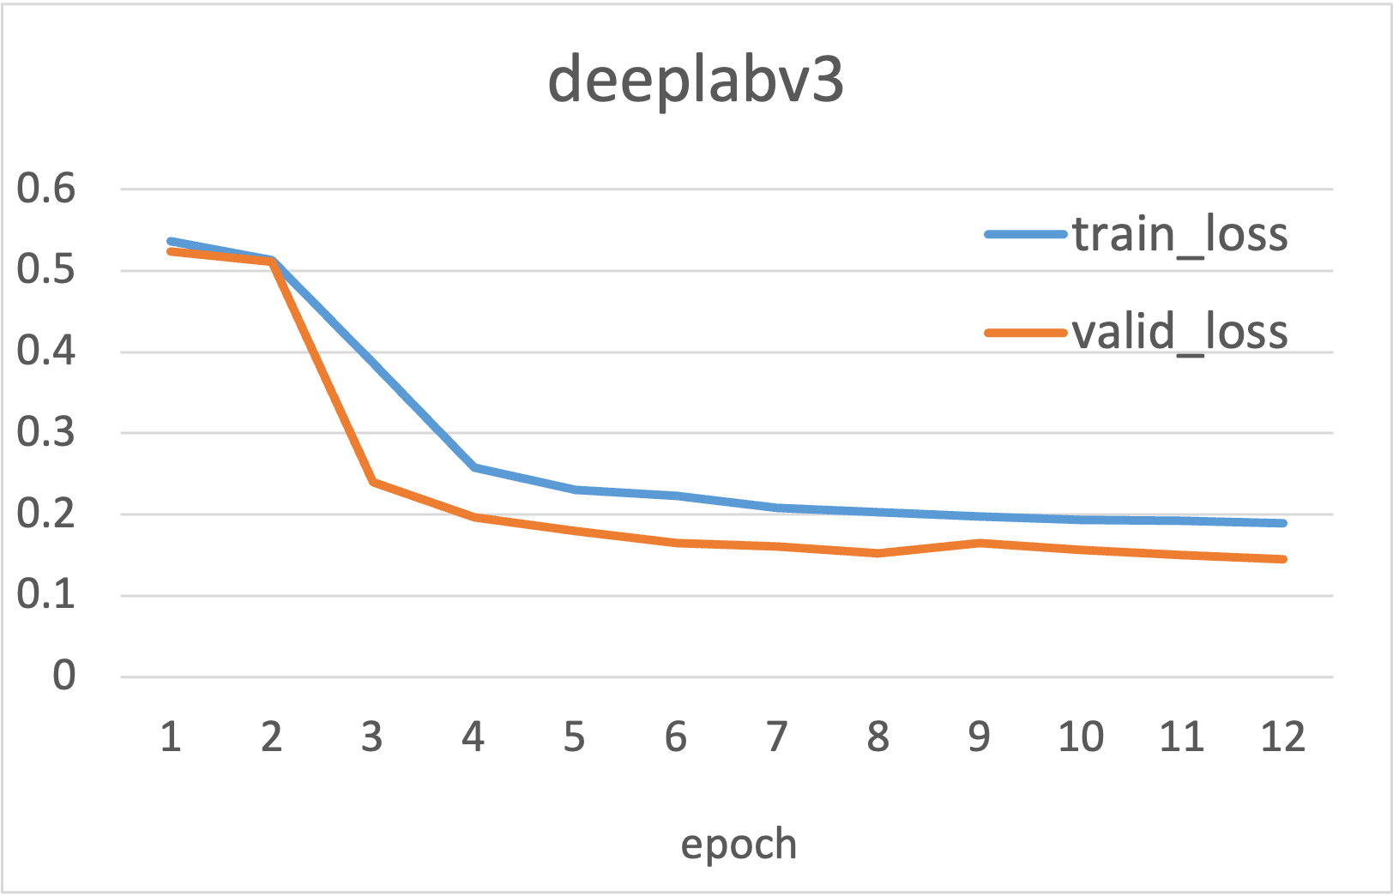
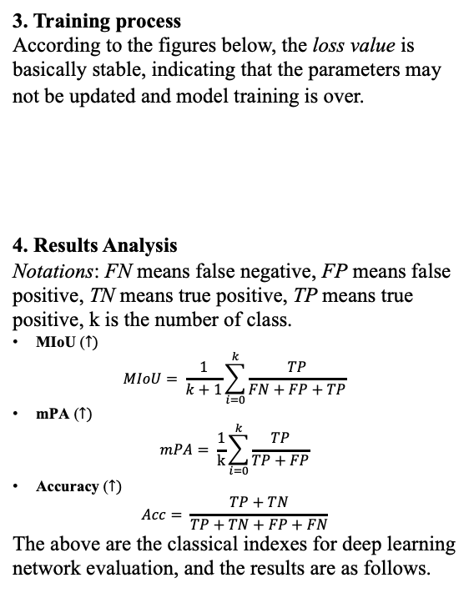
Group Member: Ling Liu(572192783@qq.com) , Jinwen Xu(ahxujinwen@163.com) Professor: Majed Al-Ghandour(mnalgha@ncsu.edu)
Solar Panel Detection From the Air: Big Satellite Imagery
Abstract
Methodology
Results
Conclusion
In order to predict detection of solar panels and analyze the socioeconomic correlates of their deployment. A big satellite imagery dataset of California’s four cities will be utilized to train some classic semantic segmentation models. We make a comparison of these models solar panel prediction accuracy and propose our conclusion.
Image segmentation is a computer vision task which labels each pixel of an image with a corresponding class of what is being represented. In our study, three semantic segmentation models are used in the study and methods, using python libraries, are as follows:
1. Data Processing
According to data augmentation, we randomly crop the original satellite images and obtain 10134 pictures of size 512*512. The data ensemble is randomly divided into 9:1, namely training set and test set which are for later model training.
2. Semantic Segmentation Models
Below are the 3 image segmentation models and their configuration. All use the pretrained models of VOC and adaptive learning rate schedulers.
2.1 Unet [2]
Backbone: VGG
Optimizer: Adam
2.2 Pspnet
Backbone: Resnet50
Optimizer: SGD
2.3 Deeplabv3
Backbone: Xception
Optimizer: SGD
3. Training process
According to the figures below, the loss value is basically stable, indicating that the parameters may not be updated and model training is over.
4. Results Analysis
Notations: FN means false negative, FP means false positive, TN means true positive, TP means true positive, k is the number of class.
MIoU ($↑)$
$$MIoU= \frac{1}{k+1}\sum_{i=0}^{k}{\frac{TP}{FN+FP+TP}}$$
mPA ($↑)$
$$mPA= \frac{1}{k}\sum_{i=0}^{k}{\frac{TP}{TP+FP}}$$
Accuracy ($↑)$
$$Acc= \frac{TP+TN}{TP+TN+FP+FN}$$
The above are the classical indexes for deep learning network evaluation, and the results are as follows.
In the detection of solar panels from the satellite imagery, Unet performs the best, which indicates it is more suitable for the few classes detection. At the same time, pspnet is simple which makes it fast convergence to the optimal solutions. Semantic segmentation of pixel-level detection will contribute to the study of usage and location deployment of solar panels, which will promote the development of renewable energy.
Introduction
Nowadays, renewable energy is closely contact with the human living environment. Solar energy is an important member of that. One classic way to measure the use of solar energy is to detect the installation of solar panels on top of houses or other buildings. With the help of deep learning, we can effectively analyze the images under the satellite, detect the number and location of solar panels in the area. The randomly cropped examples of satellite images and their label[1] (white is solar panel and black is background) are as follows：
Future
(1) Expand the applications, such as the prediction of solar panel installation site which maximize the produced energy.
(2) Extend the semantic segmentation model to semi-supervised or unsupervised domains.
(3) Put forward the improvement that is more conducive to solar panel detection.
Reference
Model | MIoU | mPA | Accuracy
Unet | 88.95 | 93.53 | 99.68
Pspnet | 67.12 | 78.38 | 98.63
Deeplabv3 | 81.02 | 89.34 | 99.38
[1]Bradbury K(2018)Distributed Solar Photovoltaic Array Location and Extent Data Set for Remote Sensing Object Identification
[2]Ronneberger O, Fischer P, Brox T. U-net: Convolutional networks for biomedical image segmentation, Springer, Cham, 2015

